Slide 1


CISC-6100: Software Engineering
Review of midterm
Status updates
…
Week 9 – November 1

Slide 2
Outline for today’s class
Review midterm
Status reports
Example project walkthrough
Data Serialization
Version control systems
Language and algorithm choice
Testing
Homework
Project time

Slide 3
Midterm Review
If you don’t understand a question – ask me
If a question seems ambiguous – ask me
For the product described in the midterm: customer != user

Slide 4

Review midterm
In an initial meeting with a potential customer, you were told the following:
We are a manufacturer of eReaders and are looking to add a new capability to our eReader: we will be adding a camera to our product and would like you to interface to that camera to use eye tracking to navigate the reading experience. Our users should be able to choose between two modes:
Page mode
Continuous mode.
In page mode the following eye movement detections will produce the actions described:
Eye focus gets to the last word on the page → turn page
Eye focus goes past the left margin → go back a page
Eye focus goes past the right margin → go forward a page
Eye focus stops on a word and user double blinks → show dictionary definition of word
In continuous mode a single line of text will horizontally scroll continuously at a specific speed. The following eye movement detections will produce the actions described:
Eye focus starts to drift to the left of the scrolling line → the speed of scrolling slows down
Eye focus starts to drift to the right of the scrolling line → the speed of scrolling speeds up
Eye focus moves above or below the scrolling line → scrolling stops
We know more controls will be needed and we aren’t even sure that our customers will like scrolling with only one line. Maybe we should use 3 lines and adjust scrolling speed based on focus moving from the middle line.
We are looking for you and your company to help us bring this idea to market.

Slide 5
Review midterm
Which of the following methods of ensuring that you and the customer have a mutual understanding of the requirements and that the requirements are complete, would you use:
use case scenarios
use case diagrams
storyboards
rapid prototypes
Choose 1 or 2 and justify your choice with 1-3 sentences each. (10 points)
Use case scenarios: Because the company states that “more controls will be needed,” these additional requirements need to be derived. One good way of eliciting what these requirements could/should be is to document possible user interactions and then how they would fit in with use of the overall system. These capabilities should be able to be specified without (yet) knowing how they will be triggered or implemented.
Rapid prototypes: Because the company is “not sure the users will like” various ways of using eye-tracking, an early on step would be to set up experiments to get preliminary user feedback. This can be accomplished with rapid prototyping, especially if the rapid prototyping does not have to produce reusable code and/or even be implemented in the product’s framework.

Slide 6
Review midterm
2. Fill in the following table. Explain each entry with a sentence. -- APIs
eReader
Page mode
Eye focus gets to the last word on the page → turn page
Eye focus goes past the left margin → go back a page
Eye focus goes past the right margin → go forward a page
Eye focus stops on a word and user double blinks → show dictionary definition of word
Continuous mode
Eye focus starts to drift to the left of the scrolling line → the speed of scrolling slows down
Eye focus starts to drift to the right of the scrolling line → the speed of scrolling speeds up
Eye focus moves above or below the scrolling line → scrolling stops
Core Software
Your Software
Camera Software
Get camera input
Figure out what to do
Internal Representations
Make something happen
View Controls

Slide 7
Review midterm
2. Fill in the following table. Explain each entry with a sentence. -- APIs
eReader
Core Software
Camera interface:
EyeFocus(x,y)
DoubleBlink(x,y)
Your Software
Camera Software
Get camera input
eReader representation interface:
e.g. WhatIsAtLocation(x,y)
Figure out what to do
Internal Representations
eReader manipulation interface:
e.g. ChangeView(directive)
Make something happen
View Controls

Slide 8
Review midterm
2. Fill in the following table. Explain each entry with a sentence. (20 points)
Input from eye tracker: What is(are) your API(s) for the eye tracker to call and what are the parameters:
void EyeFocus(x,y) → Whenever there is a (significant?) change of eye focus our software must process that change to see if an action should be triggered. The x,y parameters give the location of the focus in screen coordinates.
void DoubleBlink(x,y) → The user has double blinked at the given screen coordinate

Slide 9
Review midterm
2. Fill in the following table. Explain each entry with a sentence. (20 points)
Data required for processing input: What additional information will your code require from the core eReader software to complete processing an eye movement update:
bool IsFocusRightMargin(x,y) → returns true if the x,y screen coordinate is located in the right margin (or beyond?)
bool IsFocusLeftMargin(x,y) → returns true if the x,y screen coordinate is located in the left margin (or beyond?)
bool IsFocusLastWord(x,y) → returns true if the x,y screen coordinate is located in the bounding box of the last word
bool IsFocusLeftOfCenter(x,y) → returns true if the x,y screen coordinate is located significantly to the left of center (For use in continuous mode)
bool IsFocusRightOfCenter(x,y) → returns true if the x,y screen coordinate is located significantly to the right of center (For use in continuous mode)
string GetWordAtLocation(x,y) → returns the word at the location of focus (or empty string)
bool IsFocusUp(x,y) → returns true if the x,y screen coordinate is located above the top line of text
bool IsFocusDown(x,y) → returns true if the x,y screen coordinate is located below the bottom line of text

Slide 10
Review midterm
2. Fill in the following table. Explain each entry with a sentence. (20 points)
Customer APIs: What APIs must the customer support for the output of your code:
void PauseScrolling() → Stop the scrolling of the text and freeze what was there
void DisplayDefinition(string s) → Display the dictionary definition of the passed word
void ChangeScrollSpeed(double delta) → slows down or speeds up the scrolling speed by the factor given
bool PreviousPage( ) → Requests the system to go back one page
bool NextPage( ) → Requests the system to go forward one page

Slide 11
Review midterm
List 3 clarifying questions you would ask in your meeting and state (1 sentence) why you would ask each question. (10 points)
Is there an emulator we can use for development? – We could have much faster turn around time for rapid prototyping if we could run an emulator on our development system
Is there a technical person or team we can use for help integrating with your existing software? – Eventually existing software will have to call our code, and our code will have to call existing code. Documentation will help, but it is best to also have a technical contact.
Is there a person we should work with to perform user testing of our rapid prototypes to get feedback to finalize requirements? – As requirements weren’t finalized we need someone to work with to evaluate design iterations and decide on final version.
Time frame, Platform, …

Slide 12
Review midterm
For this question choose from the following list of core design principles (use each core principle only once; not all will be used) Choose the design principle that best describes the reason behind the action described. In one to three sentences, explain your choice. (10 points)
Divide and conquer (Separation of concerns)
Abstraction
Focus on the transfer of information
Build software that exhibits effective modularity
Look for patterns
Represent problems and solutions from a number of different perspectives
Remember that someone will maintain the software
Adjust granularity as you define the plan/design
Design of data is as important as design of processing
Because the customer is unsure of what the final operation of the eReader will be, you develop each required capability to be as minimal and standalone as possible so that these ‘pieces’ can be used by various potential solutions.
Build software that exhibits modularity – You want to design and develop modules (independent units) of software that can be reused in different configurations for the multiple iterations the functionality of the product may go through.
You study both forms of interaction for similarities.
Look for patterns – Because the two modes of operation may have overlapping capabilities you want to maximize code reuse
You create code that determines where the eye is focused, what action that focus should trigger, and the actions themselves independently of each other.
Divide and conquer – Once the communication among these aspects of the solution are finalized, developing solutions to each can be carried out independently.

Slide 13
Review midterm
Describe in outline form the steps you would take to start the design and implementation of the new eReader capability described at the beginning of this exam. You do not need to draw diagrams, but should explain what types of diagrams you might use and when. For each diagram mentioned, list the high-level content that it would include. Use references back to previous steps to describe iterative processes. Only describe the process for parts of the Software Develop Life Cycle we have covered so far (you do not need to include testing, deployment, maintenance). Your answer should be one to two pages (no more). (50 points)

Slide 14
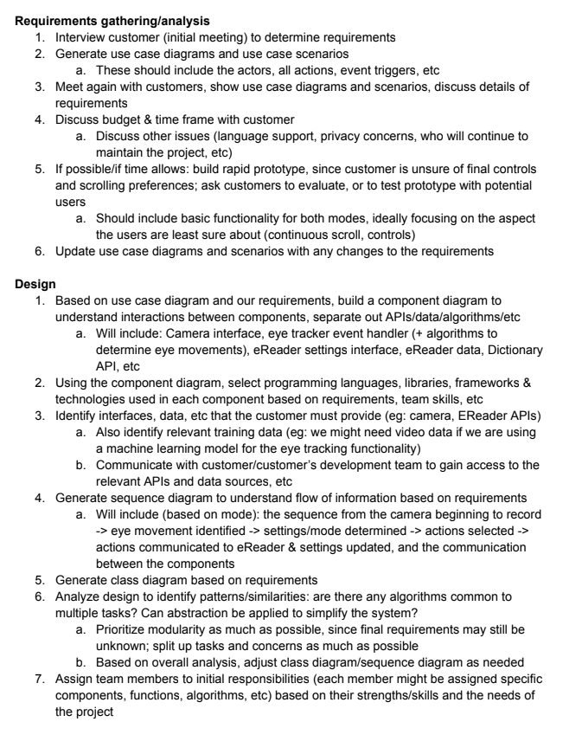
Review midterm – actual student answer

Slide 15
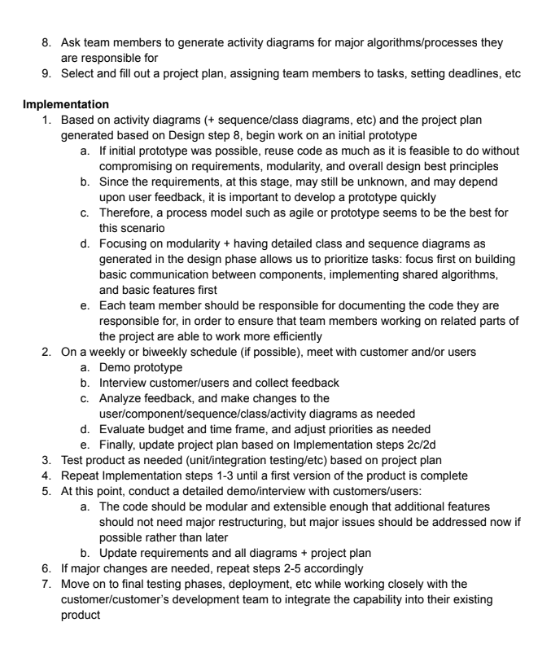
Review midterm

Slide 16
Review midterm

Slide 17
Review midterm

Slide 18
Status Reports
Status reports from teams:
Azerbaijan
Bro
C
A short verbal update on how your project is going. Please include:
What you’ve worked on in the past week
Unexpected difficulties and thoughts on mitigation
What’s gone well!
Your progress versus your plan, and any changes made to the plan
Next steps

Slide 19
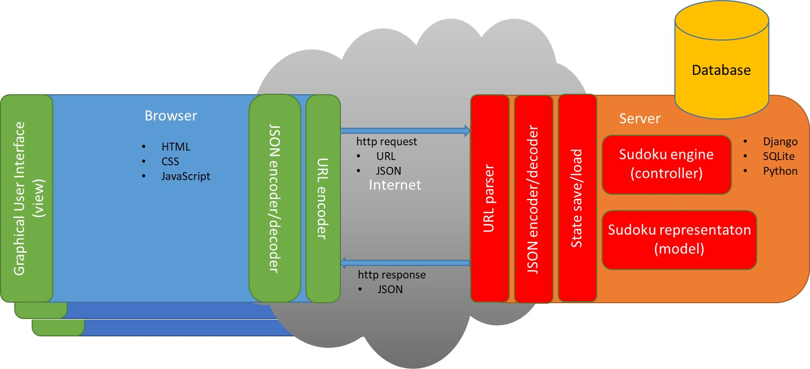
Example Project Walkthrough
Full walkthrough can be found on Blackboard in the Design elements folder.

Slide 20
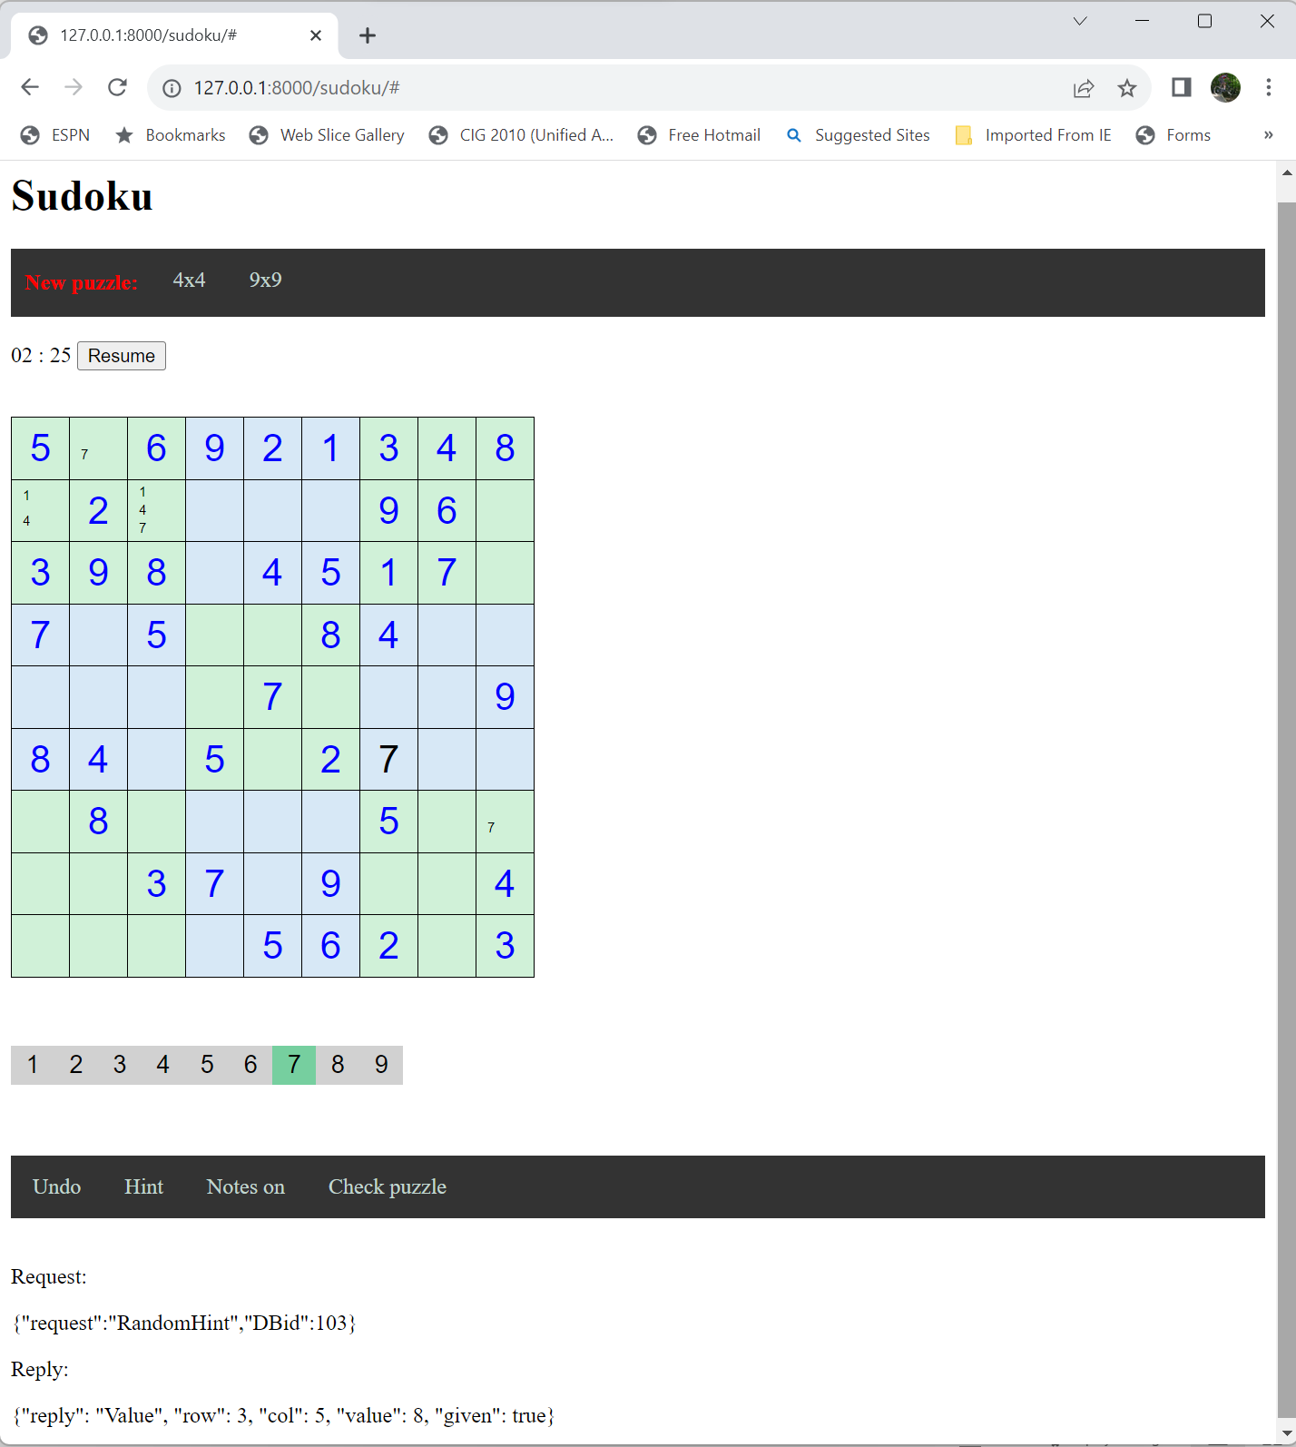
Example Project Walk Through -- Demo
http://127.0.0.1:8000/sudoku/

Slide 21
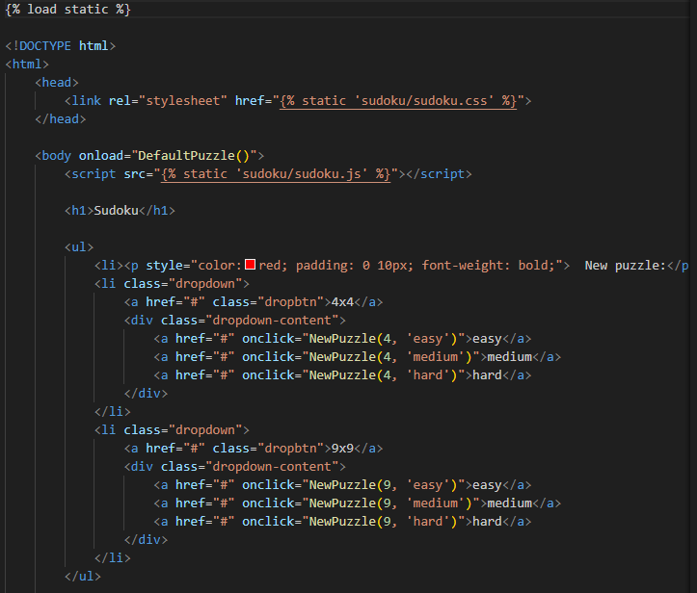
Example Project Walk Through – HTML
Load in the CSS “code”
Load in the JavaScript code
Set up top menu

Slide 22
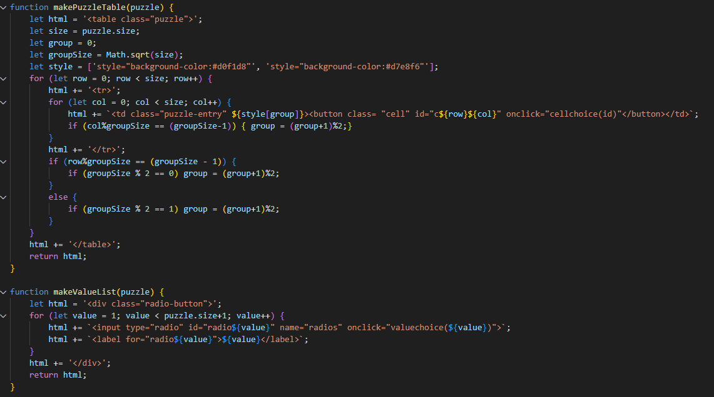
Example Project Walk Through – JavaScript
Set up the puzzle display and event notifications / handlers
Set up the numeric entry choices with event notifications / handlers

Slide 23
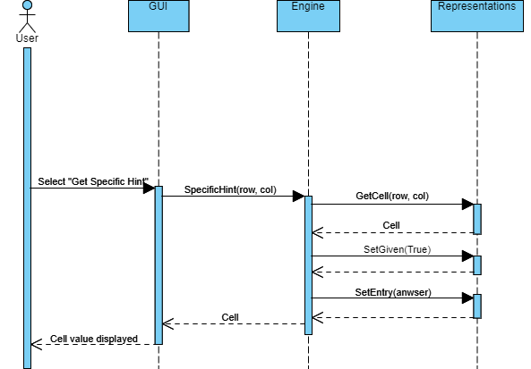
Example Project Walk Through – Specific Hint
Hint mode
setHintMode()
Hint displayed
Select cell

Slide 24
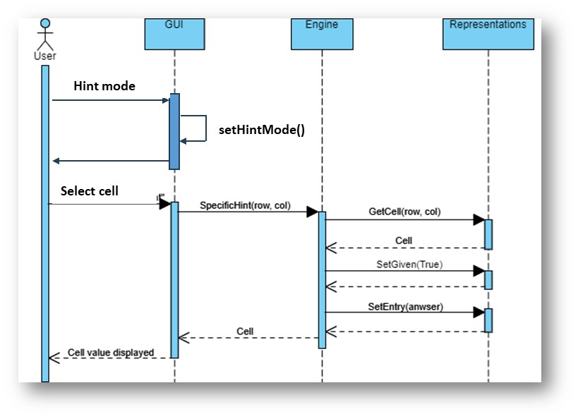
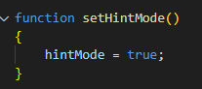
Example Project Walk Through – Specific Hint

Slide 25
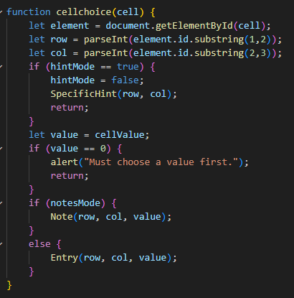
Example Project Walk Through – Specific Hint

Slide 26
…

Slide 27
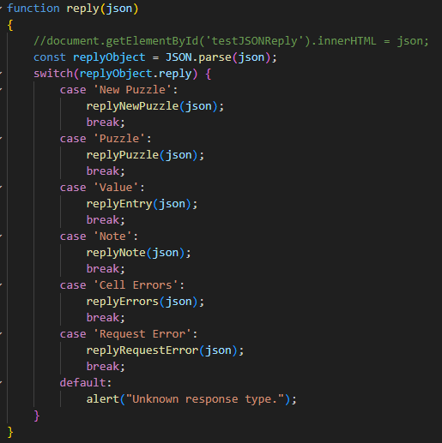
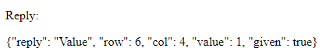
Example Project Walk Through – Specific Hint

Slide 28
Data Serialization

Slide 29
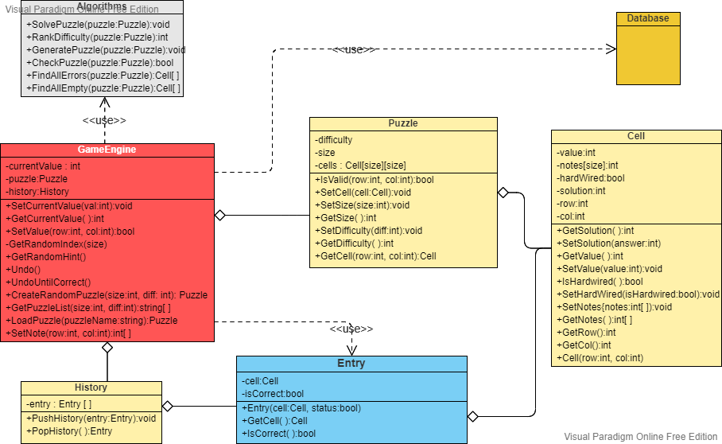
Serializing data/objects and sharing them
Serialize/deserialize: In computing, serialization is the process of translating a data structure or object state into a format that can be stored (e.g. files in secondary storage devices, data buffers in primary storage devices) or transmitted (e.g. data streams over computer networks) and reconstructed later: deserialization (possibly in a different computer environment). https://en.wikipedia.org/wiki/Serialization

Slide 30
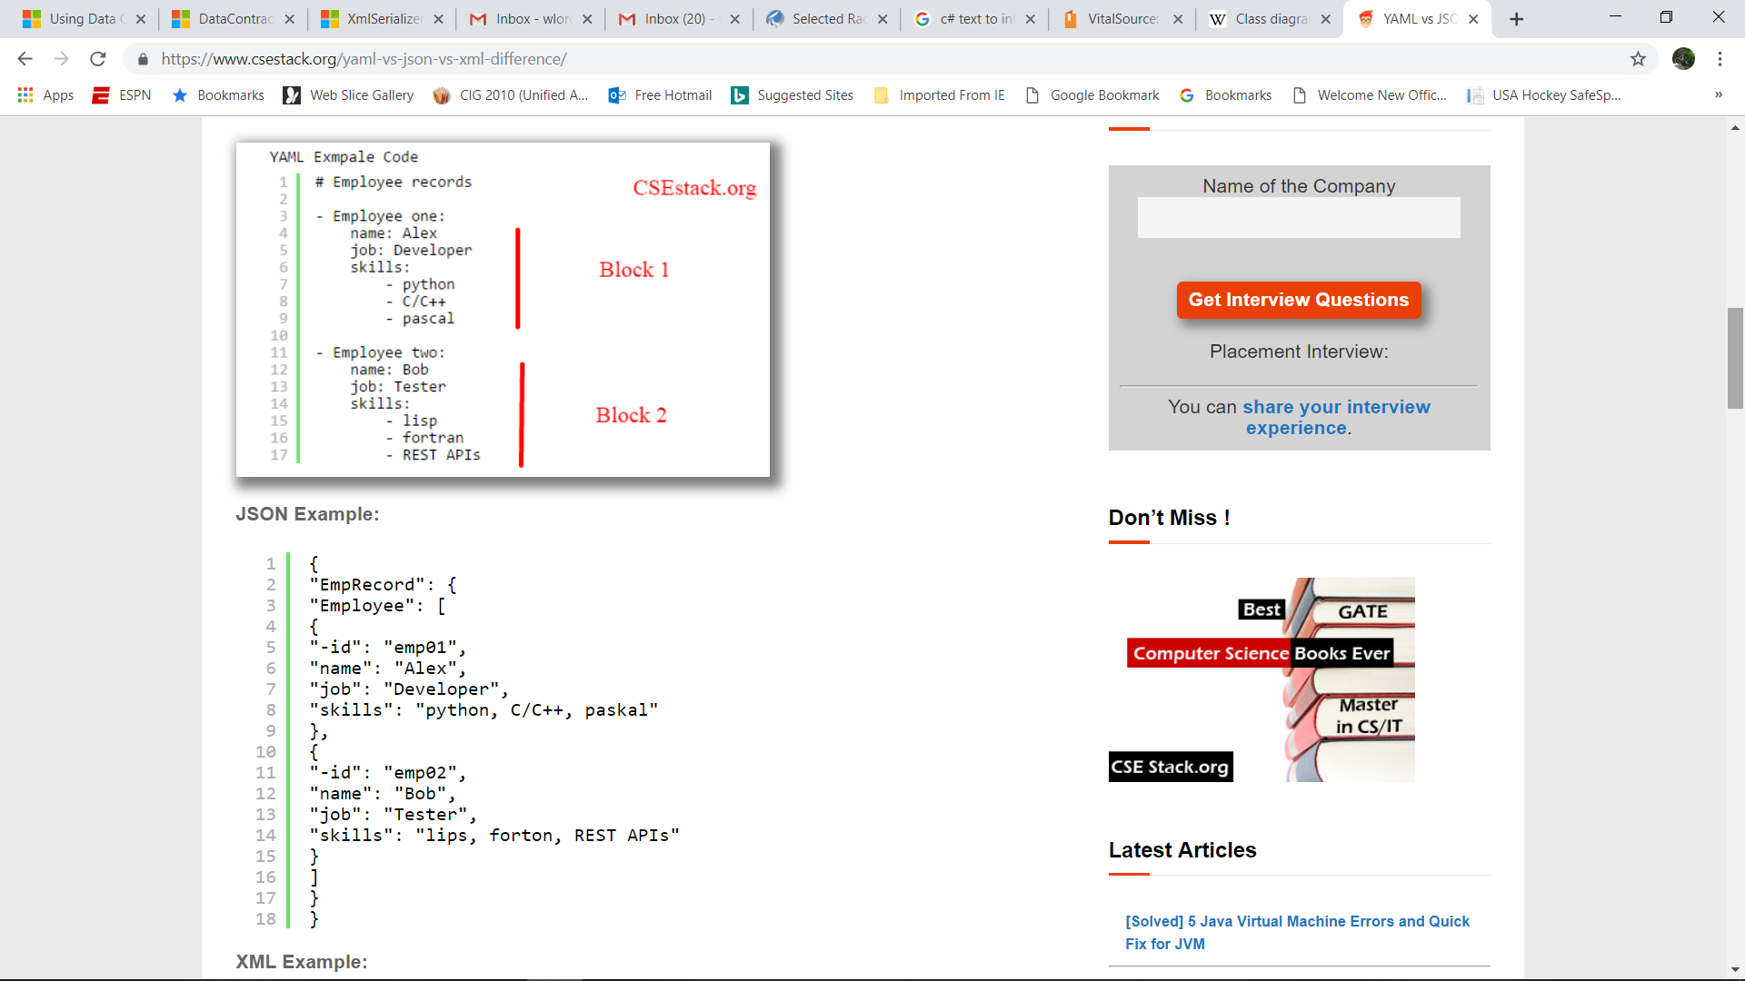
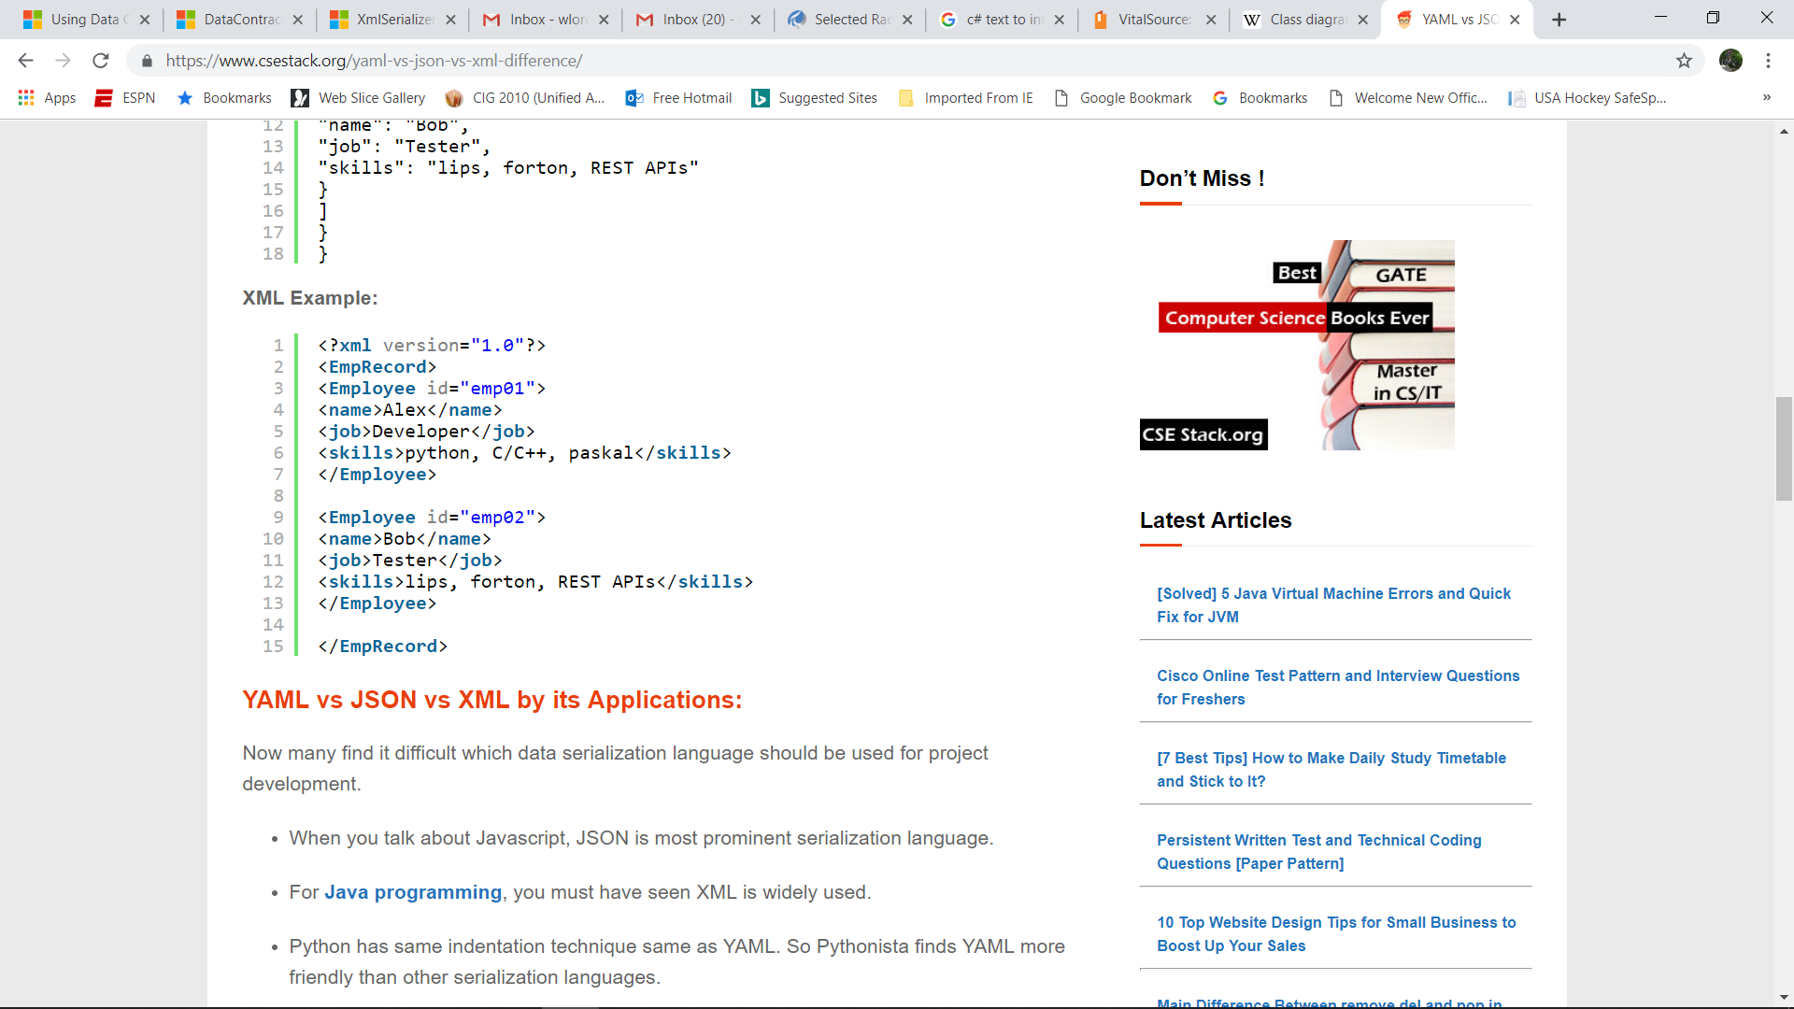
Serializing data/objects
https://medium.com/geekculture/yaml-vs-json-vs-xml-in-go-bf4ebd1066f2
Compares readability, speed, size
https://www.csestack.org/yaml-vs-json-vs-xml-difference/

Slide 31
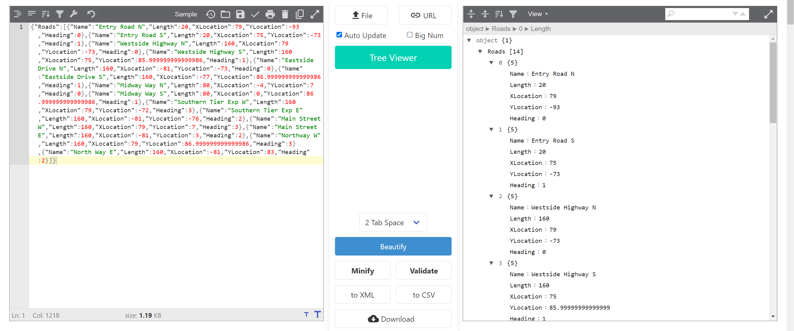
Serializing data/objects

Slide 32
Serializing data/objects and sharing them
Languages that support introspection and/or reflection typically have strong built-in or library support for serializing/deserializing objects to/from JSON:
Python
C#
Java
JavaScript
Depending on what you want to do, one line of code can create a JSON string from your (possibly nested) objects
In languages that don’t, it can be much more difficult to serialize/deserialize objects:
C
C++

Slide 33
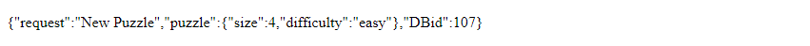
JSON syntax diagram
JSON
,
“string“
{
“
identifier
“
:
number
}
Boolean
[ Json ]
{ Json }

Slide 34
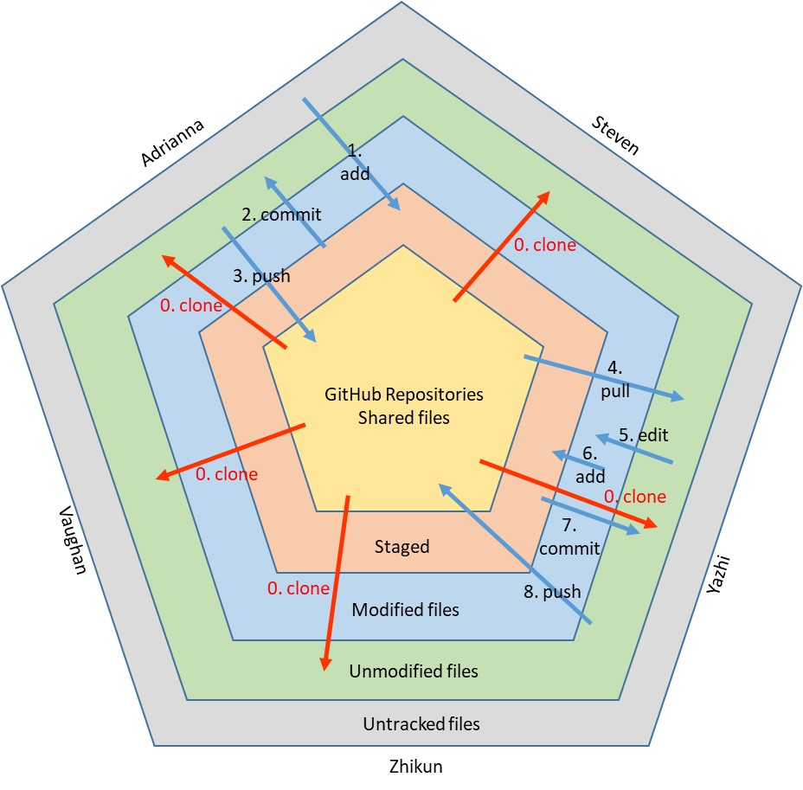
Version Control Systems

Slide 35

Version Control Systems –quick review
What do they do for an individual?
Help automate versioned storage of files/documents
Provide roll back to previous versions
Provide a history of modifications
Show differences between versions
What types of documents?
Manuals
Code
Drawings
Make files
What do they do for a team?
Provide a repository of shared documents
Integrate work by multiple people
Provide automated joining of files edited simultaneously by 2 or more team members
Provide tools for conflict resolution when simultaneously edited files have conflicts
Examples
SCCS
CVS
Subversion
Git

Slide 36
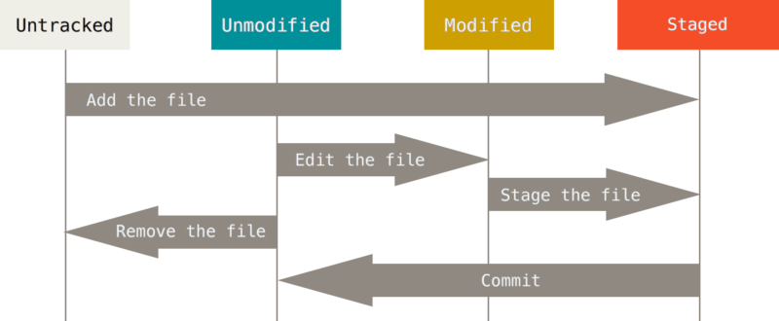
Adrianna
1. add
Steven
Single User
2. commit
Untracked
Unmodified
Modified
Staged
0. clone
3. push
0. clone
4. pull
GitHub Repositories
Shared files
5. edit
6. add
0. clone
0. clone
Vaughan
7. commit
Staged
0. clone
Yazhi
8. push
Modified files
Unmodified files
Untracked files
Zhikun

Slide 37
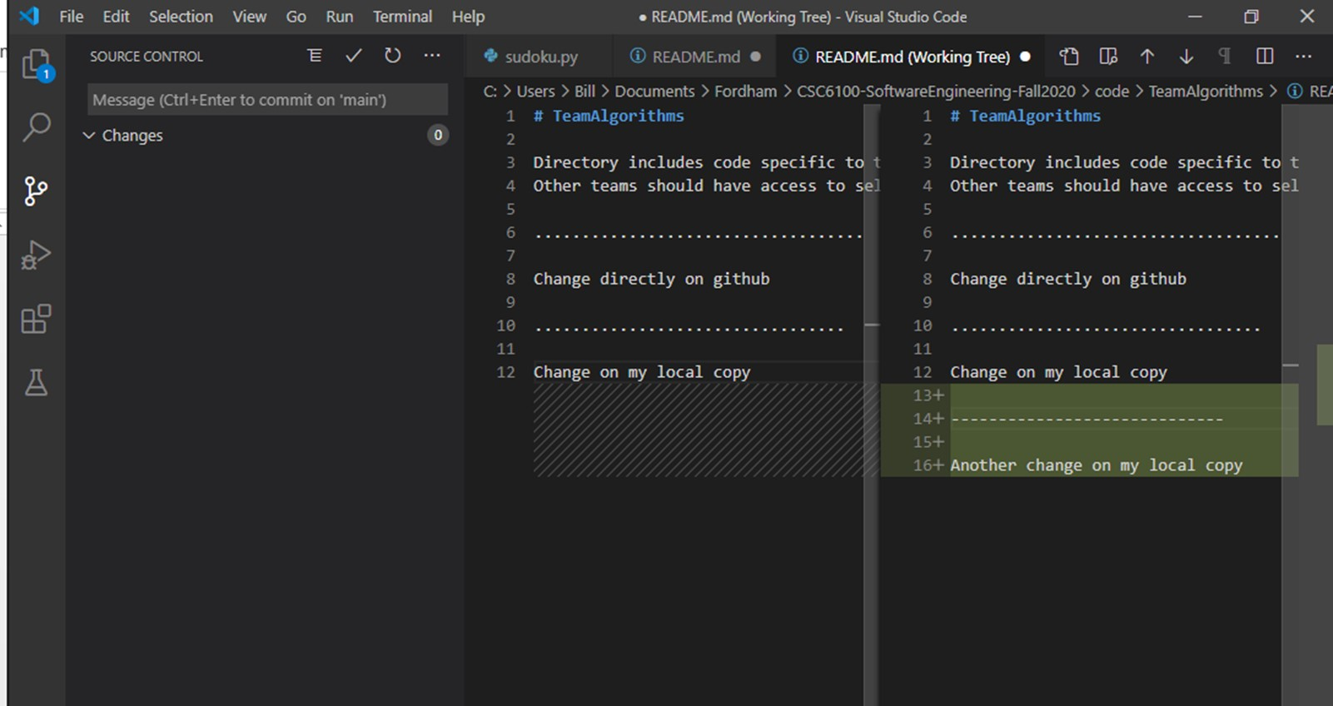
Use an editor that supports Git
Make change locally
Stage changes
Commit changes
Push changes

Slide 38
In the other direction: Bringing changes from the remote/shared code to your local workspace.
Good practice to do before you start editing locally.
Make change remotely
Pull changes locally

Slide 39
Language and algorithm choice

Slide 40
Language choice:
You have no choice.
You are working on an existing project
You are working for a company that dictates which language(s) to use
You are working on a specific platform
Ease of writing code
Ease of writing correct code
Speed of resulting code
Access to libraries
Interfaces with other languages/code
You already know the language
Writing secure code
Availability of advanced development environments
It’s your favorite
You have a choice.

Slide 41
Algorithm choice:
Availability
Cost
Speed of algorithm
Ease of implementation
Documentation
Extensibility
Memory requirements

Slide 42
Language and algorithm choice
Fibonacci Sequence
F₀= 0, F₁= 1,
and
F_{n} = F_{n-1} + F_{n-2} for n > 1.
0, 1, 1, 2, 3, 5, 8, 13, 21, 34, 55, 89, 144, …

Slide 43
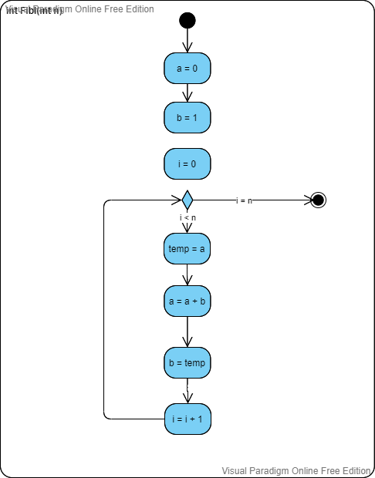
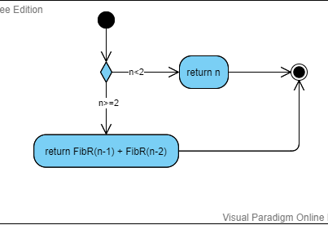
UML activity diagram for two approaches to Fibonacci sequence
Iterative
Recursive
return a

Slide 44
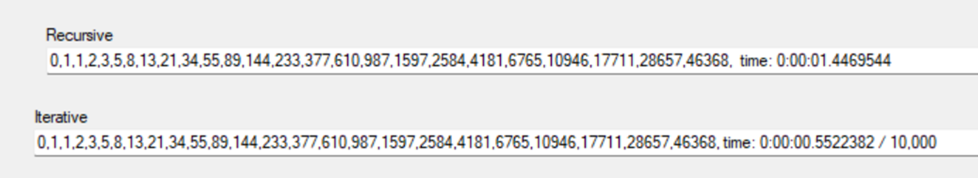
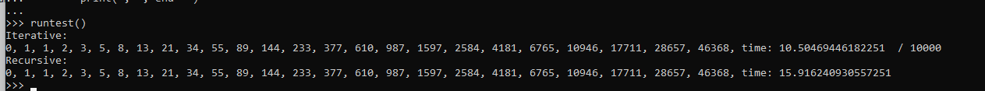
Example output: C#
Example output: Python
 | C# | Python | Language speed
Iterative | .00005 | .00105 | ~20x diff
Recursive | 1.45165 | 15.91624 | ~10x diff
Algorithm speed | ~30,000x diff | ~15,000x diff

Slide 45
8
F₀= 0, F₁= 1,
and
F_{n} = F_{n-1} + F_{n-2} for n > 1.
6
5
3
5
4
3
2
2
1
4
3
3
2
2
1
1
1
1
1
1
0
3
2
2
1
2
1
1
0
1
1
1
0
1
0
1
0
In this example recursion with memoization runs at a speed comparable to the iterative version.
2
1
1
0
1
0
1
0
1
0
1
0

Slide 46
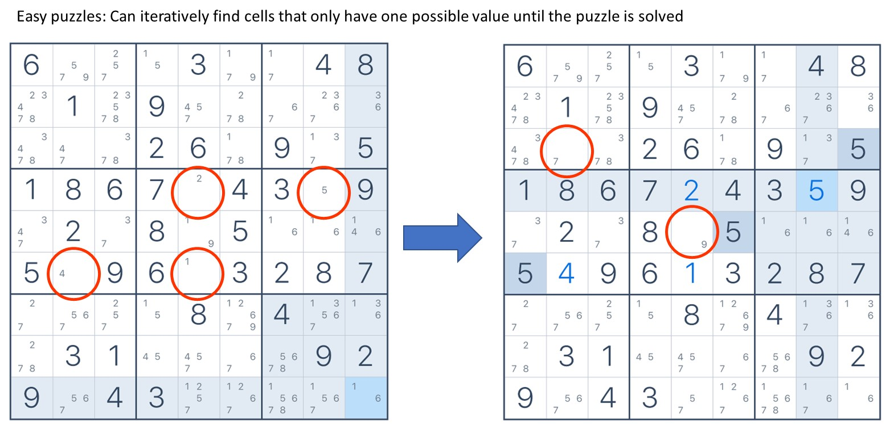
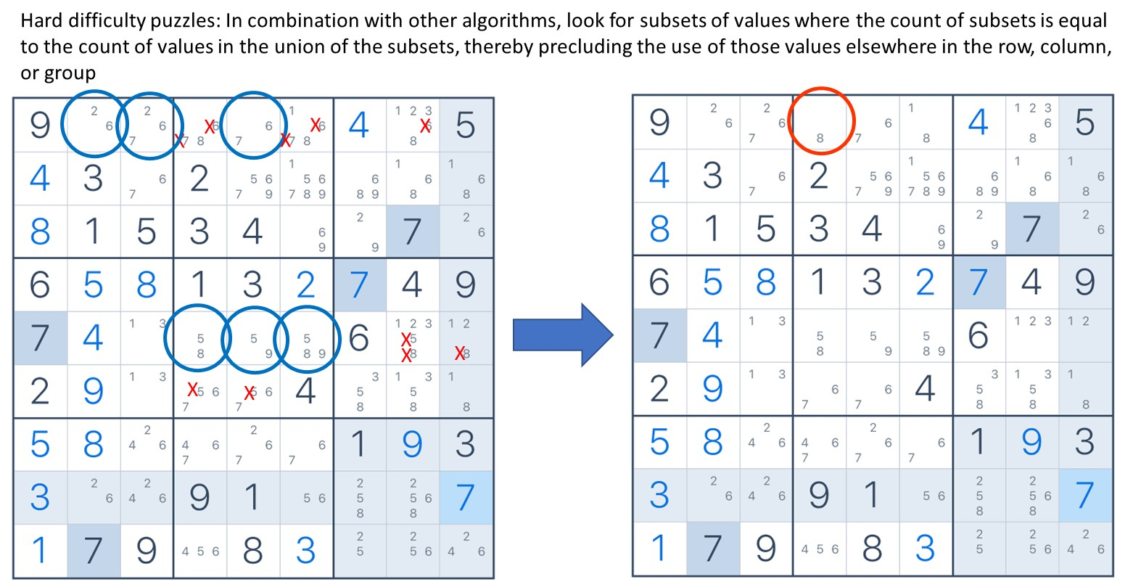
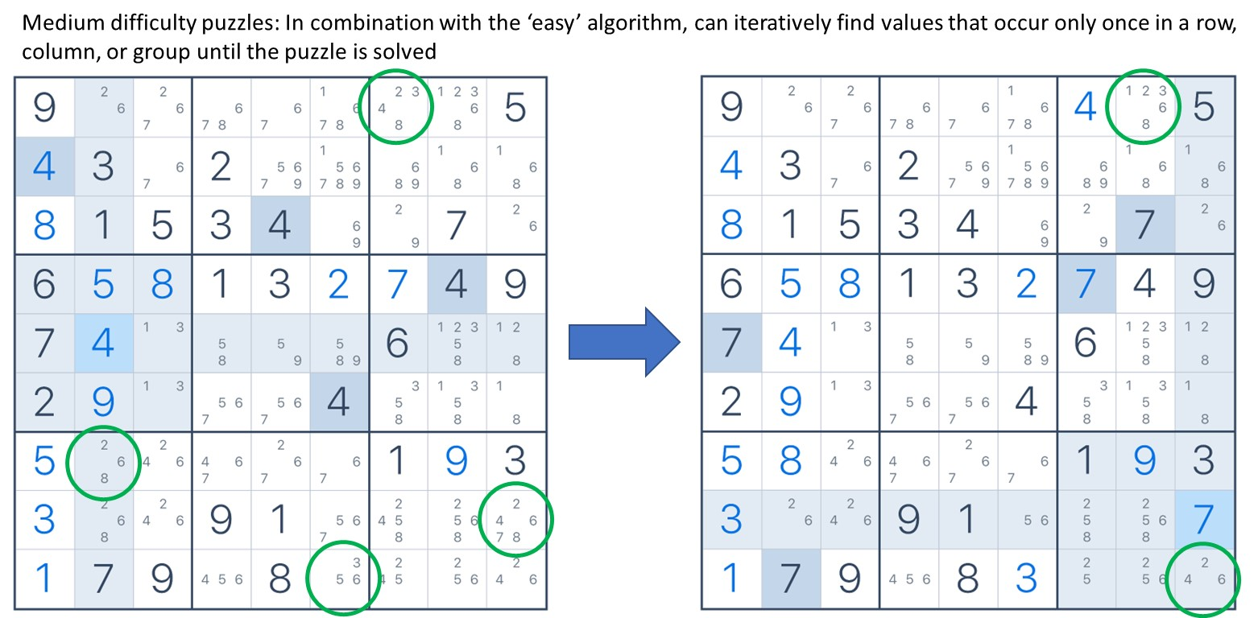
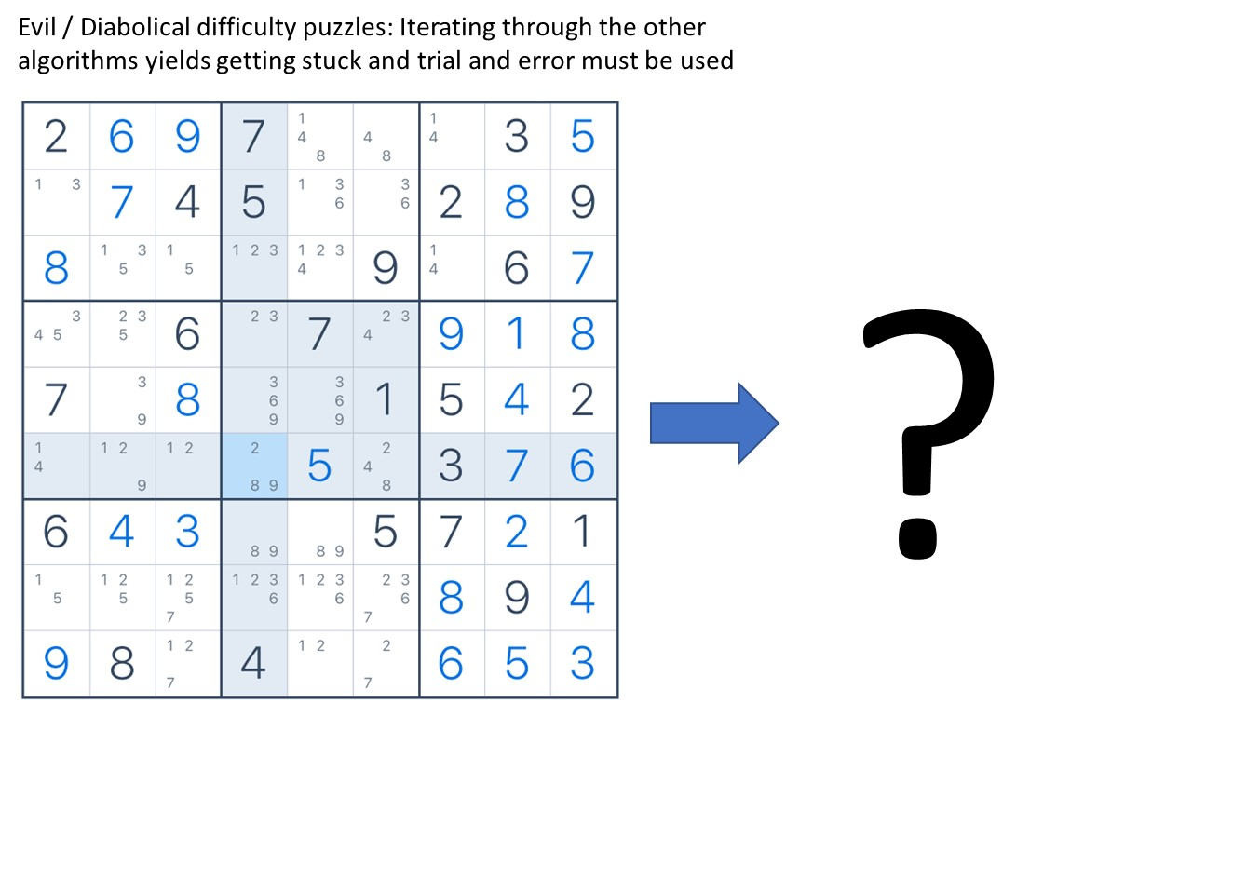
Algorithms to solve Sudoku puzzles

Slide 47
Algorithms to solve Sudoku puzzles
Demo time…
Show how the brute force / recursive algorithm works (rundemo())
Show the timing of the brute force versus hybrid brute force/heuristics algorithms (TimeSolutions())
Show the timing of integrated hybrid approach (TimeSolutions())
Further speed ups:
Run heuristics every iteration of brute force method
Implement more heuristics (e.g., looking at subsets of values)
More importantly (maybe)…
Is the faster, heuristic enhanced code worth the extra ~100 lines of code
Are additional speed ups necessary
What might be a better way to spend a programmer’s time
Could speed ups be left for later

Slide 48
Approach to coding
Use existing resource (Web service, library, code for purchase, code for pay per use)
Repurpose existing code
Use design patterns
Code from scratch

Slide 49
Testing

Slide 50
Testing
Glossary:
Ground truth: information that is known to be real or true, provided by direct observation and measurement (i.e. empirical evidence) as opposed to information provided by inference. (https://en.wikipedia.org/wiki/Ground_truth)
Black-box testing: a method of software testing that examines the functionality of an application without peering into its internal structures or workings. This method of test can be applied virtually to every level of software testing: unit, integration, system and acceptance. It is sometimes referred to as specification-based testing. (https://en.wikipedia.org/wiki/Black-box_testing)
White-box testing (also known as clear box testing, glass box testing, transparent box testing, and structural testing): a method of software testing that tests internal structures or workings of an application, as opposed to its functionality (i.e. black-box testing). In white-box testing, an internal perspective of the system is used to design test cases. The tester chooses inputs to exercise paths through the code and determine the expected outputs. (https://en.wikipedia.org/wiki/White-box_testing)
Gray-box testing: a combination of white-box testing and black-box testing. The aim of this testing is to search for the defects, if any, due to improper structure or improper usage of applications. (https://en.wikipedia.org/wiki/Gray_box_testing)
Stubs: a piece of code used to stand in for some other programming functionality. A stub may simulate the behavior of existing code (such as a procedure on a remote machine; such methods are often called mocks) or be a temporary substitute for yet-to-be-developed code. (https://en.wikipedia.org/wiki/Method_stub)

Slide 51
Testing
Glossary:
Test driver: the wrapper/mechanism that organizes the tests, runs them, and handles their output. (https://stackoverflow.com/questions/22082382/what-exactly-is-a-test-driver)
Edge case: testing that typically involves input values that require special handling in an algorithm behind a computer program. (https://en.wikipedia.org/wiki/Edge_case)

Slide 52
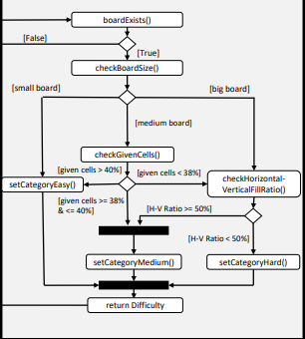
Testing
Unit testing:
Low-level testing. Typically done at the function level or class/method level in object-oriented programming.
Testing of algorithms
Tests written by code developers as they develop code.
Black-box, Gray-box, or White-box testing
Should test against:
Known “good” input
Known “bad” input
Edge cases
def fib(n):
count = 0
c, b = 0, 1
while count < n:
c, b = b, c+b
count = count + 1
return c

Slide 53
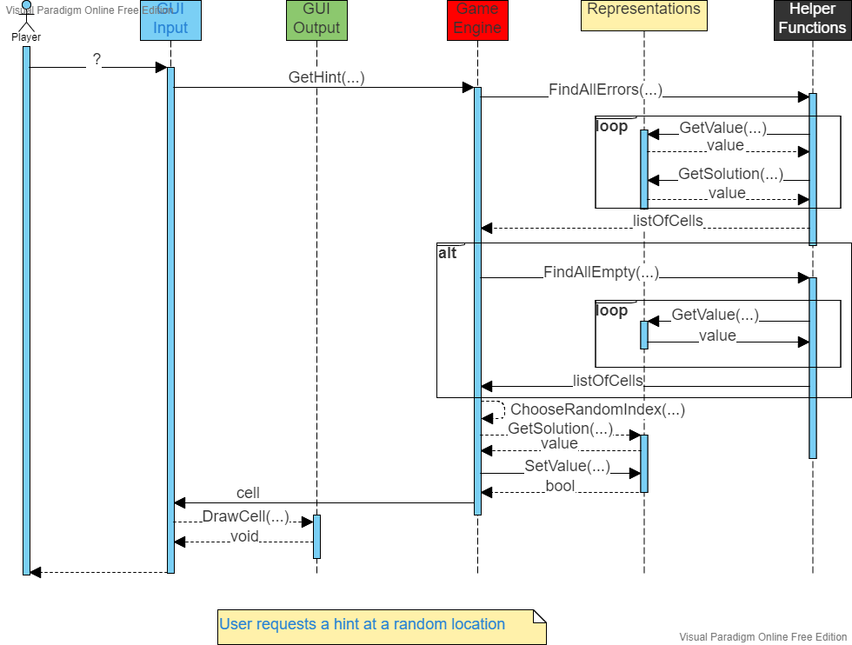
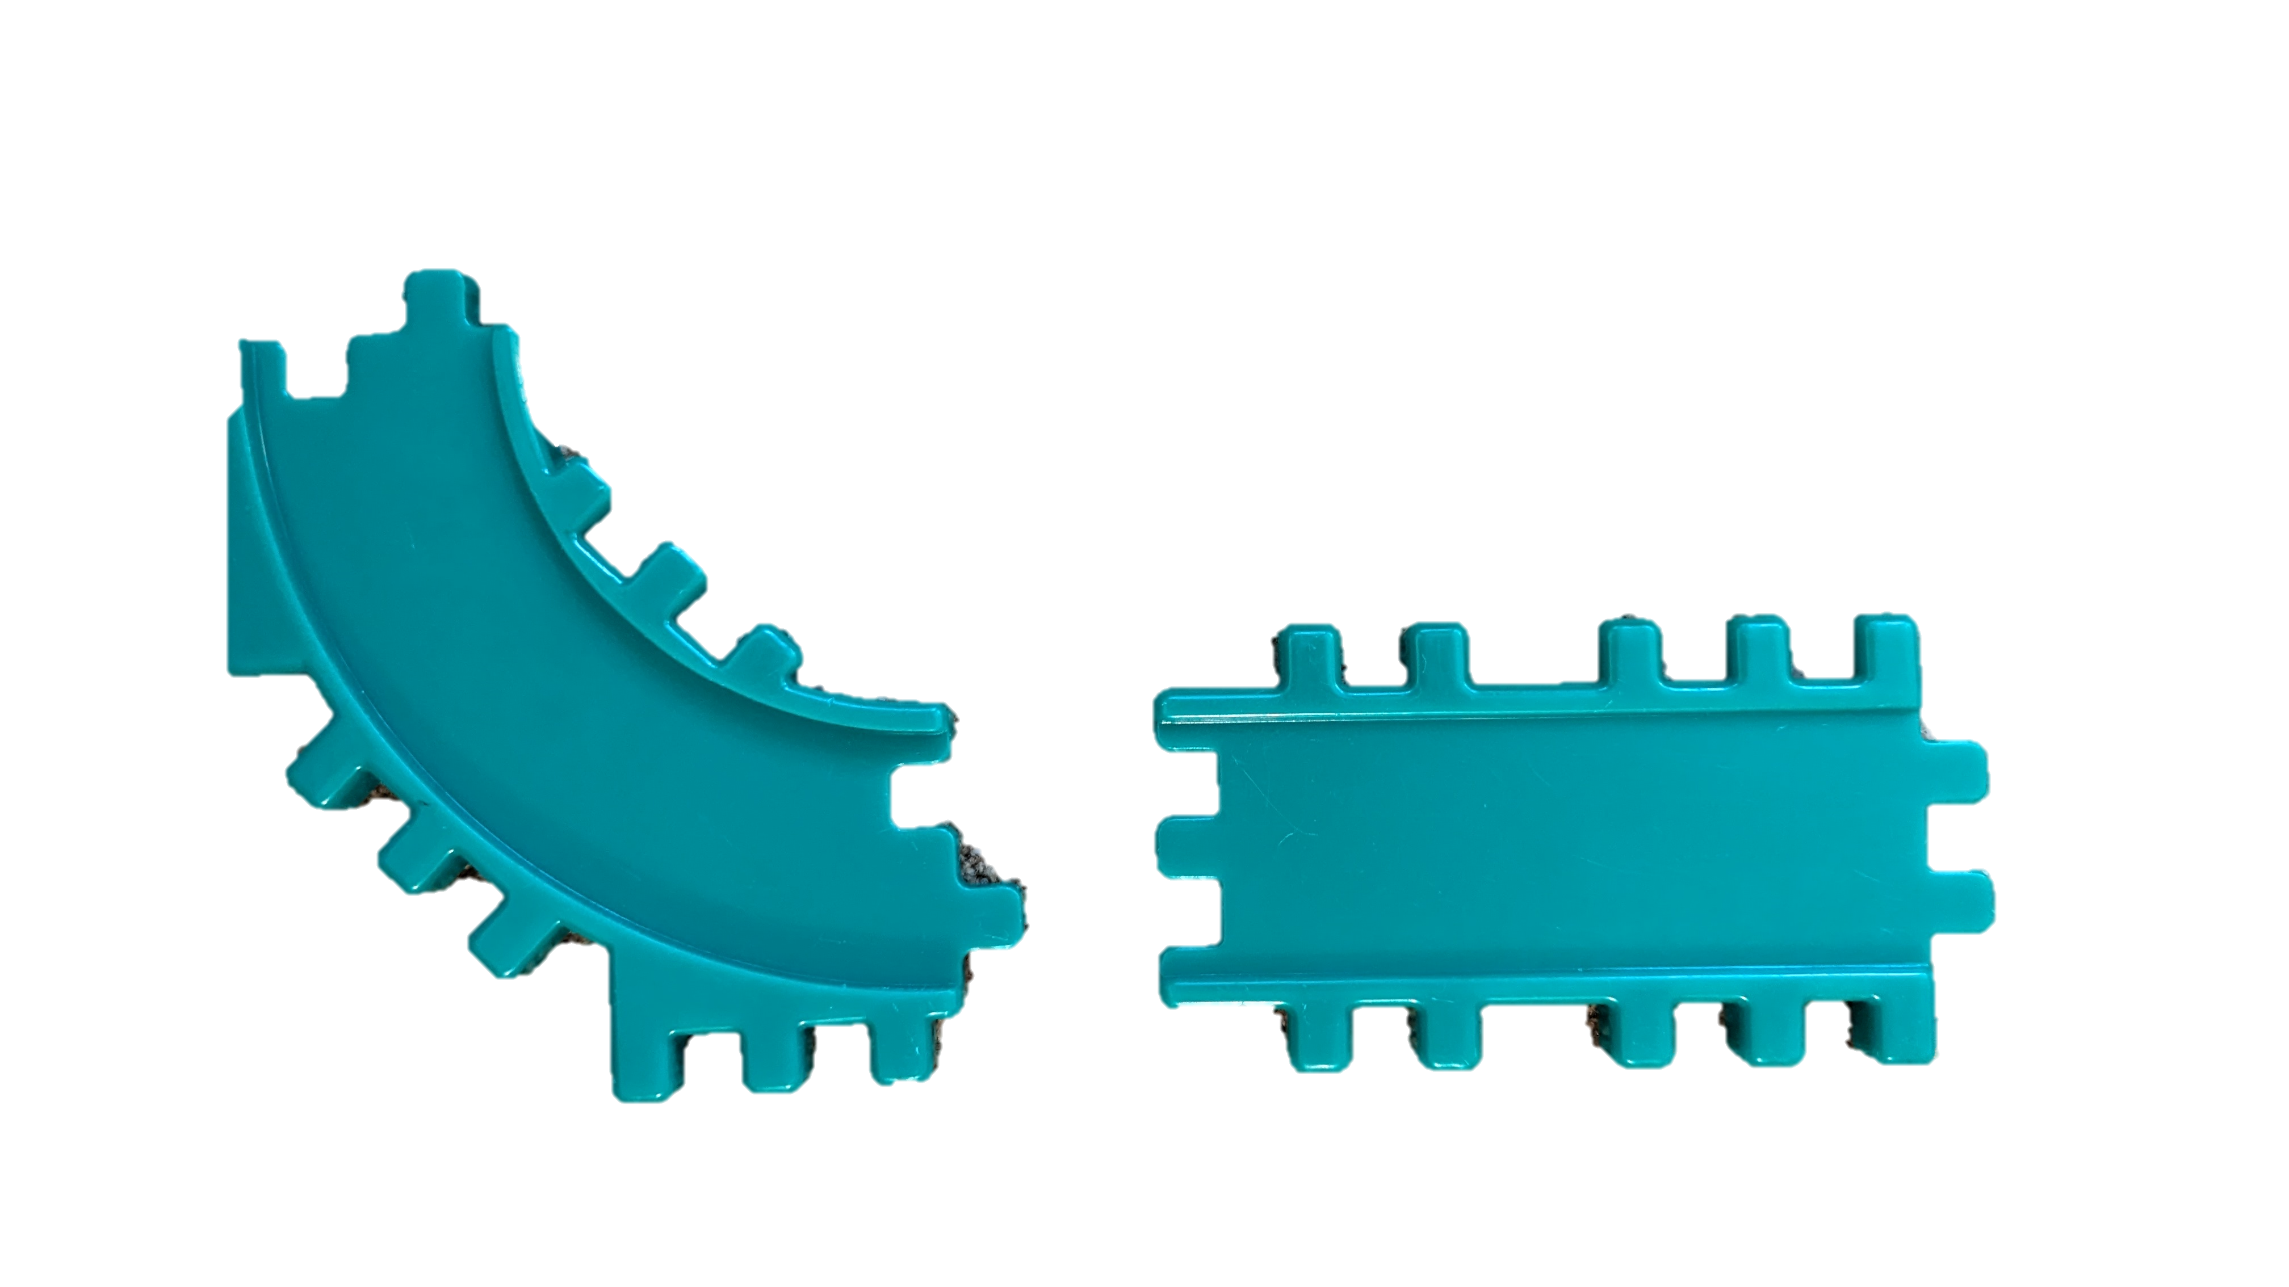
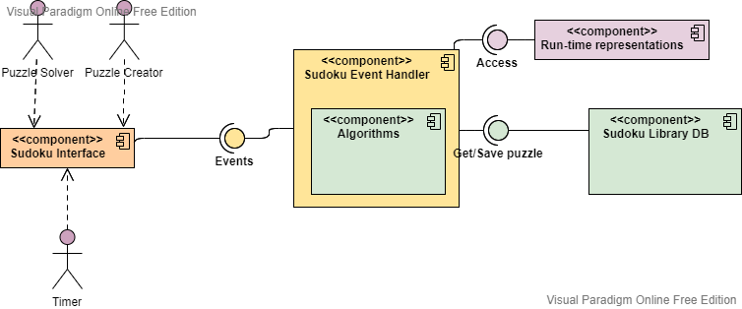
Testing
Integration testing:
Testing interfaces among components
Can be tested before components are completed by use of “stubs”
Progressively done on larger and larger groups of software components
Black-box and/or Gray-box testing

Slide 54
Testing
Example of driver:
public bool TestHintAtRandomLocation(Puzzle puzzle) {
try {
Cell cells[] = Algorithms.FindAllErrors(puzzle);
cells[] = Algorithms.FindAllEmpty(puzzle);
Cell cell = GetCell(1,1);
int sol = cell.GetSolution();
cell.SetValue(sol);
}
catch {
// log error or write message
return false;
}
return true;
}

Slide 55
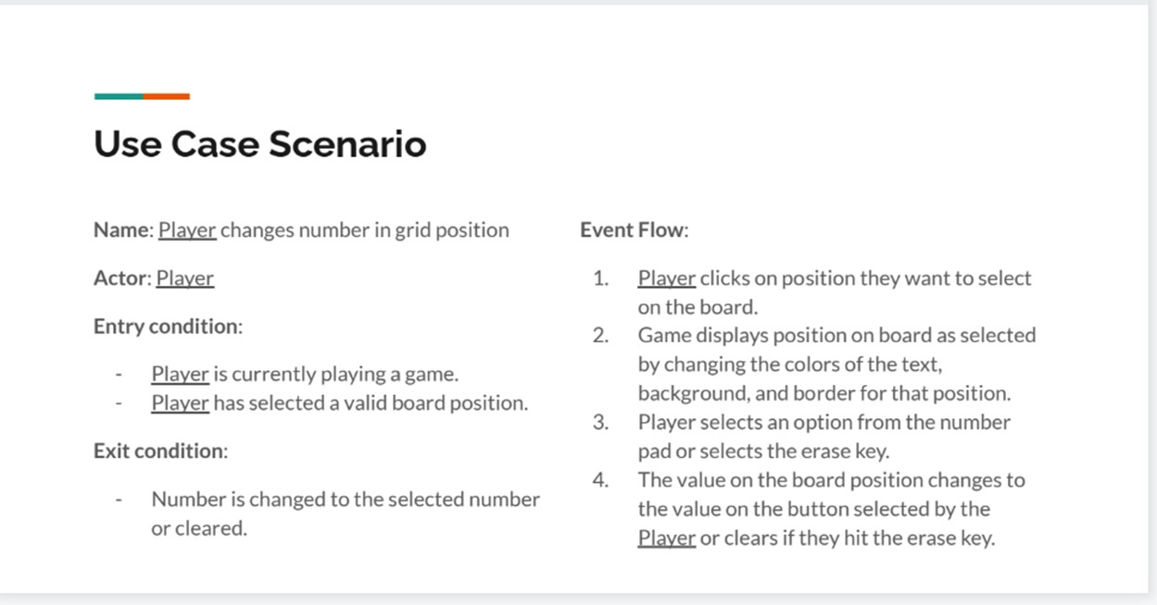
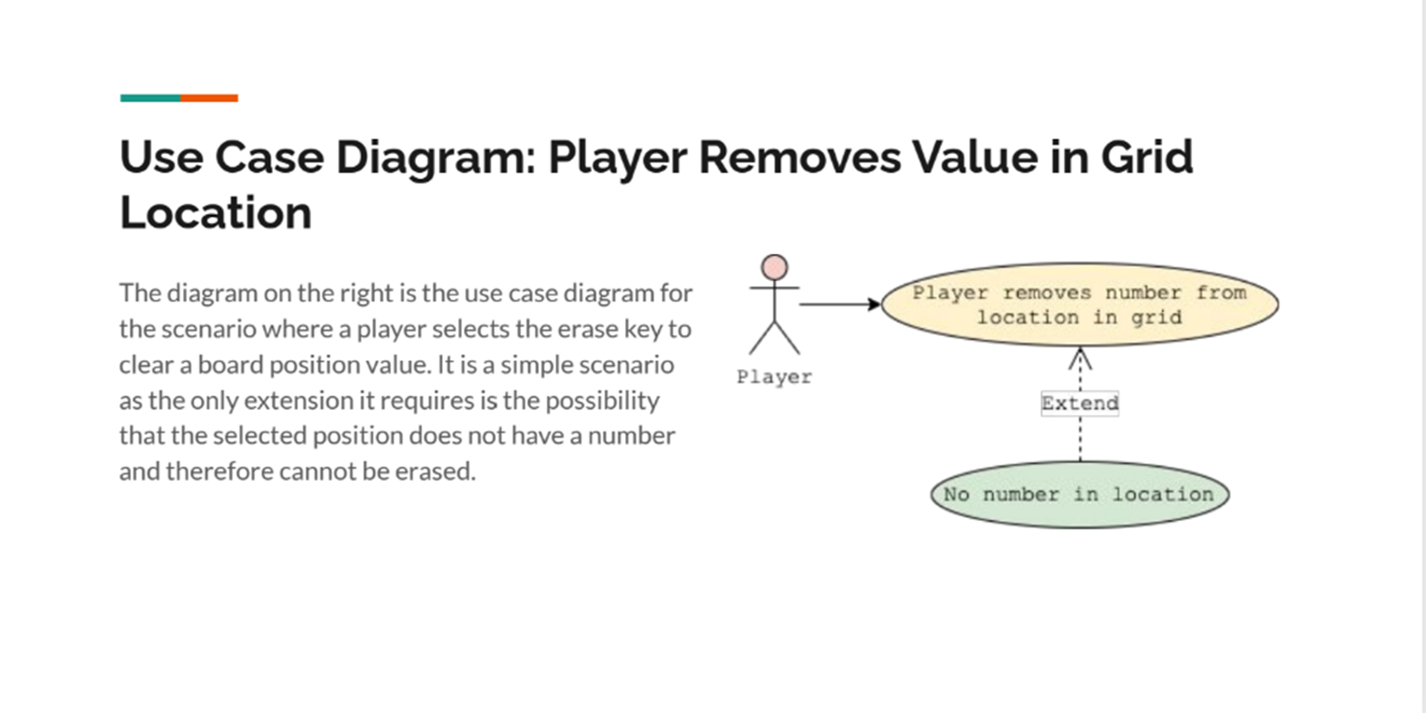
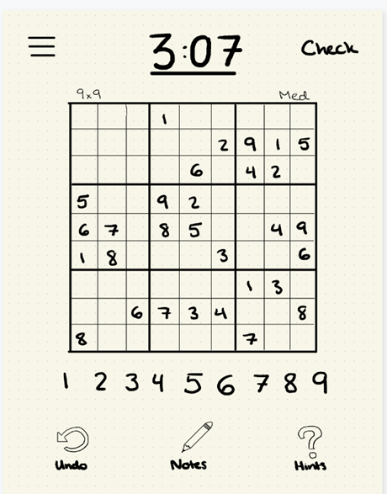
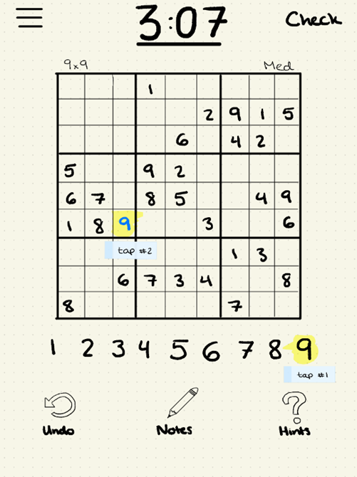
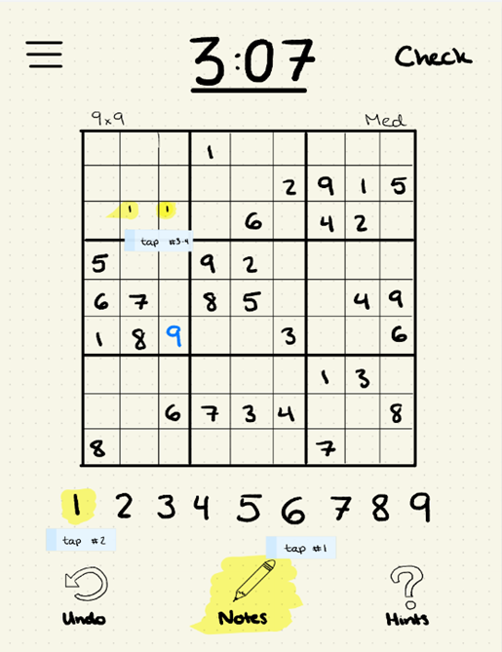
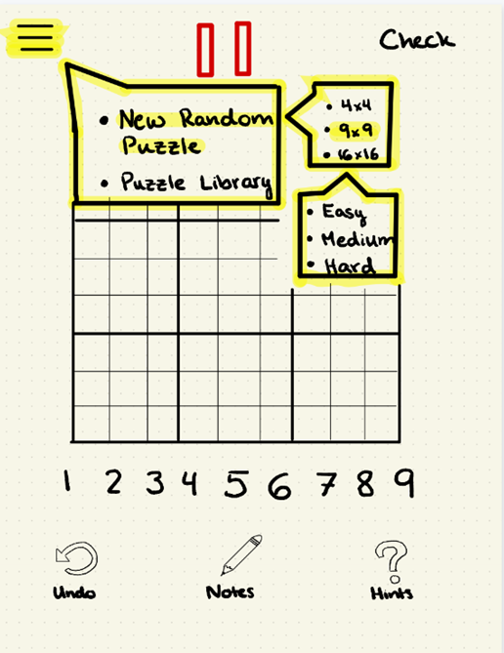
Testing
System testing:
Testing of completed system against its requirements
Black-box and/or Gray-box testing

Slide 56
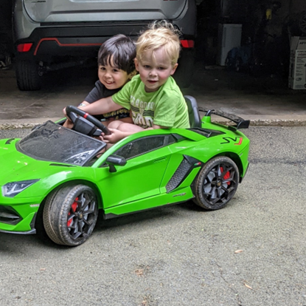
Testing
Acceptance testing:
User testing
Regulatory testing
Alpha / beta testing

Slide 57
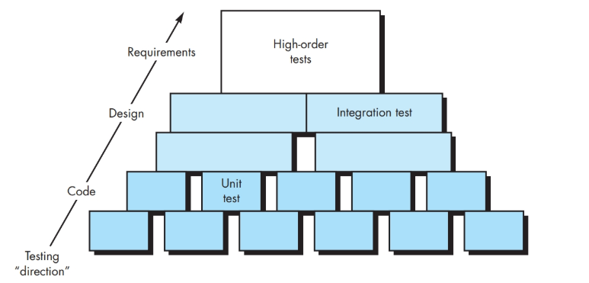
Testing
Test-case design
Types
Levels
Unit
Boundary
Stubs
Integration
Top-down
Depth-first
Breadth-first
Stub out lower levels
Bottom-up
Drivers for upper levels
Regression testing
Validation – response time
System
Recovery testing
Security testing
Stress testing
Performance testing
Deployment testing
Test execution
Data collection and evaluation

Slide 58
Junit (example of how to create Drivers for testing when “upper” levels are missing. And much more…)
import org.junit.*;
public class FoobarTest {
@BeforeClass
public static void setUpClass() throws Exception {
// Code executed before the first test method
}
@Before
public void setUp() throws Exception {
// Code executed before each test
}
@Test
public void testOneThing() {
// Code that tests one thing
}
@Test
public void testAnotherThing() {
// Code that tests another thing
}
@Test
public void testAnotherThing() {
// Code that tests another thing
}
@Test
public void testSomethingElse() {
// Code that tests something else
}
@After
public void tearDown() throws Exception {
// Code executed after each test
}
@AfterClass
public static void tearDownClass() throws Exception {
// Code executed after the last test method
}
}
Test results can be written to the console, a file, or even a spreadsheet
A research survey performed in 2013 across 10,000 Java projects hosted on GitHub found that JUnit (in a tie with slf4j-api), was the most commonly included external library. Each library was used by 30.7% of projects
From: https://en.wikipedia.org/wiki/JUnit

Slide 59

More on testing
Python Example
def DiabolicalGame():
return [
[
[[0,0,4], [0,2,0], [6,0,0]],
[[5,0,1], [0,8,0], [0,0,0]],
[[9,0,0], [0,3,0], [0,0,5]]],
[[[0,0,8], [0,5,0], [0,0,3]],
[[7,0,6], [0,0,0], [4,0,8]],
[[3,0,0], [0,9,0], [5,0,0]]],
[[[3,0,0], [0,8,0], [0,0,2]],
[[0,0,0], [0,7,0], [8,0,5]],
[[0,0,9], [0,6,0], [1,0,0]]
]]
g = DiabolicalGame()
Stub used to set up use of a driver

Slide 60
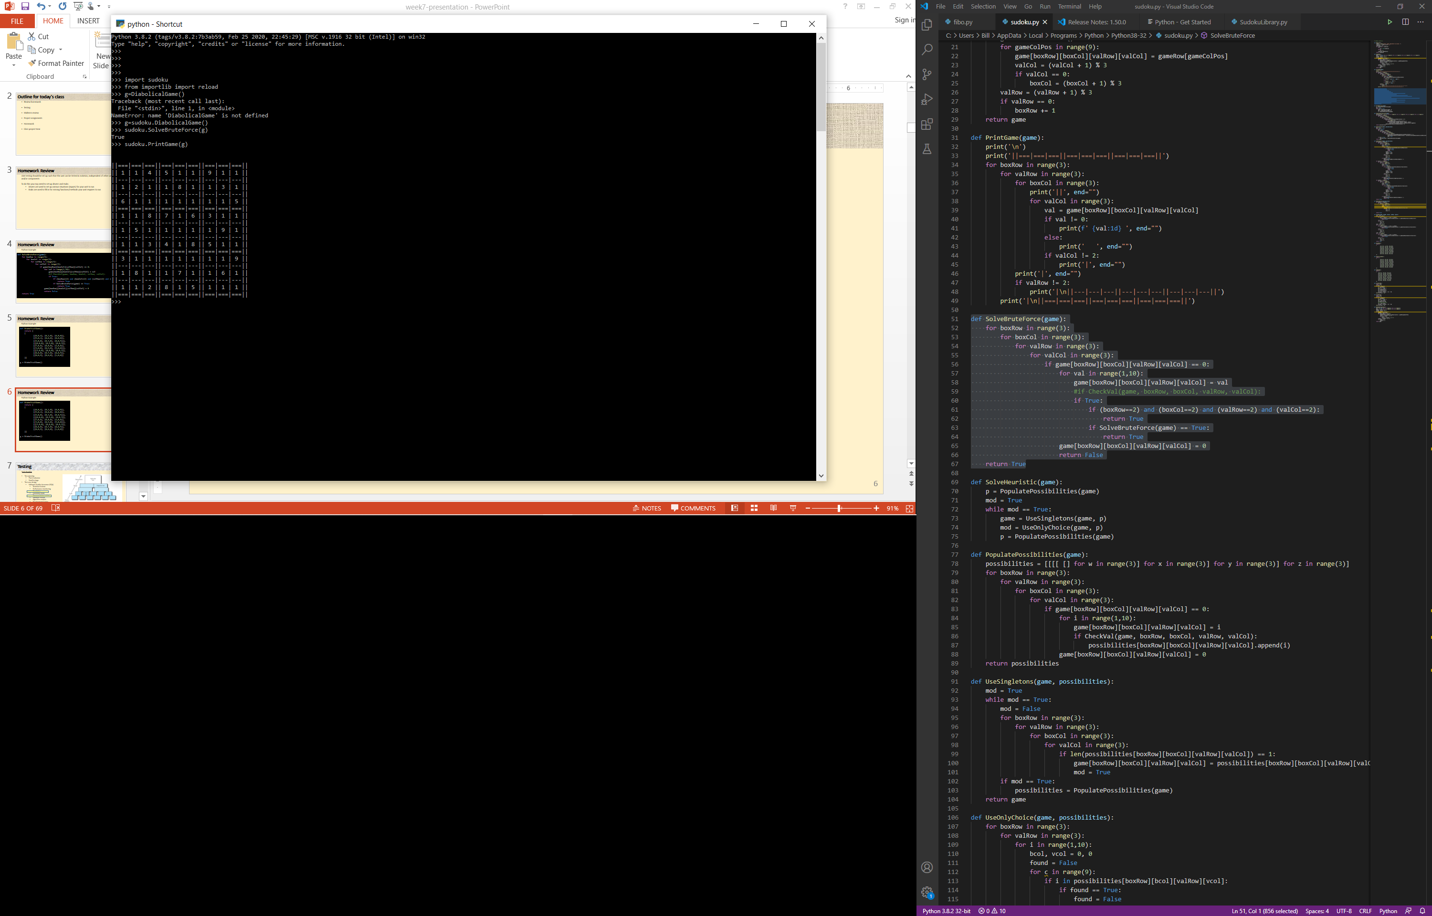
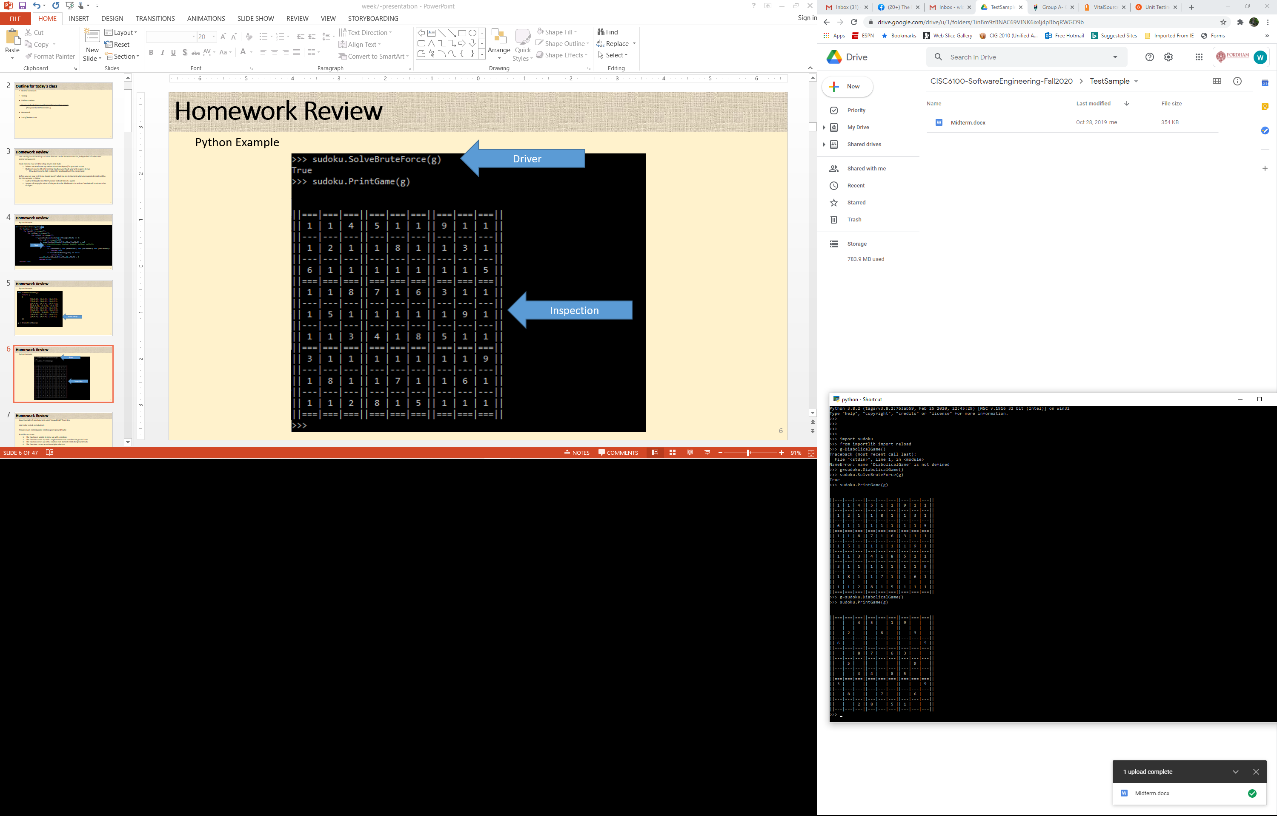
More on testing
Driver
Inspection

Slide 61
Testing
Testing gone too far?
Where should it be tested?
GUI
GetHint(col, row)
Control
GetHint(col, row)
Representation
GetKey(col, row)
col<9
row<9
col<9
row<9
col<9
row<9

Slide 62
Testing
Input validation
GUI
Algorithms and storage
Database
Expert System
0<=HR<=300
SBP>=DBP
…

Slide 63
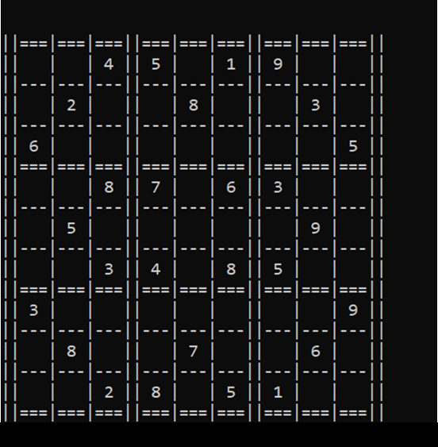
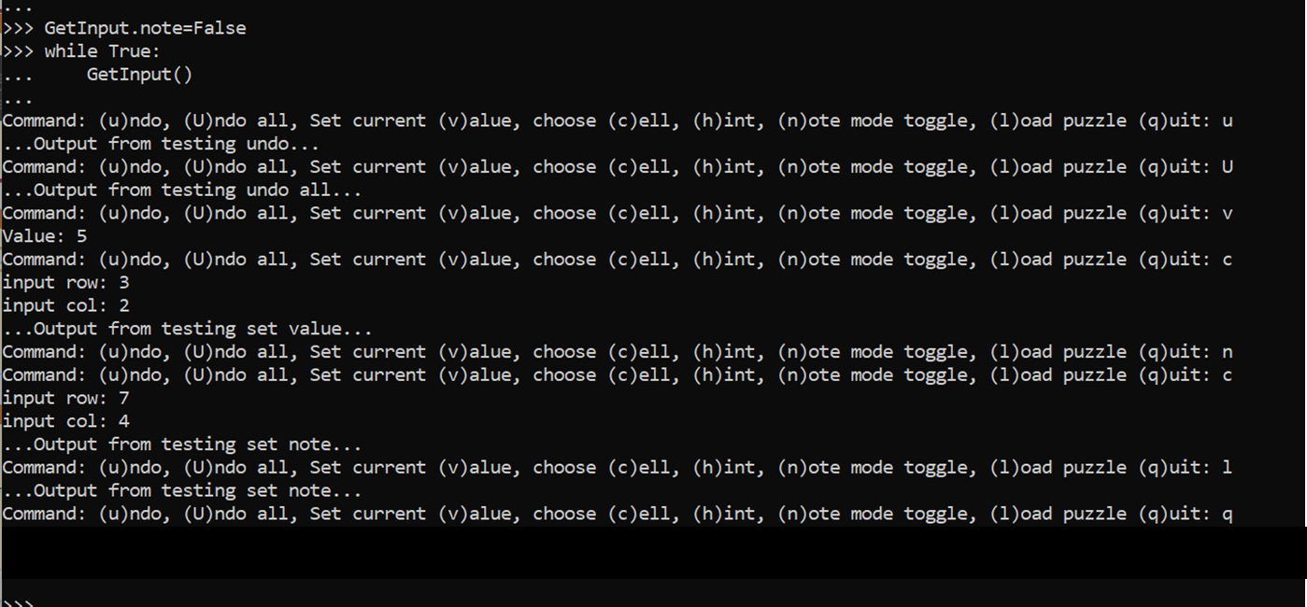
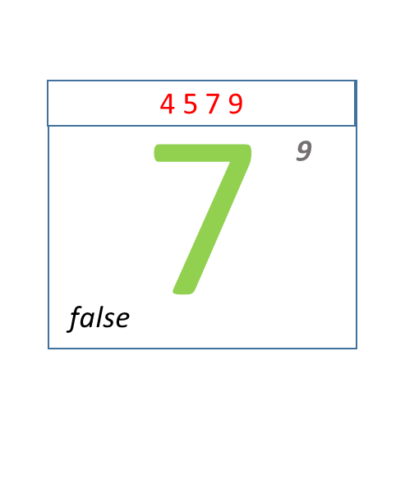
Project
Example from stubs to show output
Example output from driver to test overall system

Slide 64
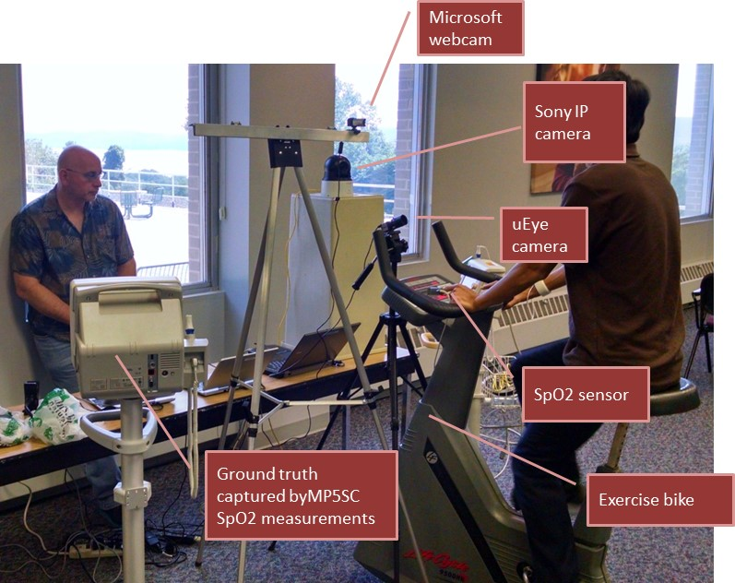
Actual example: performance testing
Hardware
Software
Short tangent… (Roles of a SW engineer)
Quick look at the many tasks of Software Engineers though the lens of an actual project:
Started with a technology without an application
Learning of needs in the industry
Acquiring domain knowledge (clinical)
Acquiring domain knowledge (business)
Study potential technology-based solutions and non-technological solutions
Develop a business case
Storyboard
Prototype key components
Testing - IRB
Applying for grants

Slide 65
For each of the following describe how you might design the testing to be run before final release:
Video game –
Bank’s money transfer app –
SpaceX re-entry code –
Sudoku puzzle solver –
Tax return software (e.g. TurboTax) -
Sudoku puzzle solver -

Slide 66
For each of the following describe how you might design the testing to be run before final release:
Video game –
Bank’s money transfer app –
SpaceX re-entry code –
Sudoku puzzle solver –
Tax return software (e.g. TurboTax) -
Sudoku puzzle solver -
For each of the following describe how you might design the testing to be run before final release:
Video game – As this is not critical (relatively speaking) you could start with internal testing by employees and their families, and then when more mature start beta testing with select customers.
Bank’s money transfer app – This is more critical; field testing is not an option. Set up internal testing with fake accounts. Test bi-directionally, to/from all types of accounts (checking, savings, money market); test with small amounts, large amounts, high-precision amounts, negative amounts; test where currency exchange would be required; test for any involved fees.
SpaceX re-entry code – Life critical, “failure is not an option.” Set up extensive modelling environment and test in the model.
Sudoku puzzle solver – Create test suite from the 1000s of readily available games. Run solution on the test suite. Fix any bugs and repeat testing until no more bugs detected. (Regression testing)
Tax return software (e.g. TurboTax) - Hire a tax expert (e.g. CPA) to validate results of test run on a large collection of example tax returns. Use someone who knows nothing about tax returns to test usability, and handling of illegal data entry.

Slide 67
Homework assignment
Homework for November 11^{th -} Nothing to hand in
If not familiar with GitHub, read and experiment with https://guides.github.com/activities/hello-world/
Clone your team’s GitHub repository
Change a (Readme) file
Push updated file back
Status reports from teams:
D
Edamame
F
A short verbal update on how your project is going. Please include:
What you’ve worked on in the past week
Unexpected difficulties and thoughts on mitigation
What’s gone well!
Your progress versus your plan, and any changes made to the plan
Next steps

Slide 68
Project time

